Slide 1

Approaches to text analysis
in the Humanities
Sarah McEleney, The University of Virginia

Slide 2
Today’s Outline
1) Discussion of historical approaches to reading texts and review of technologies. Discussion of text analysis with DH. Ways to read a text, voyant, Google n-grams, online tools with no programming needed.
2)Basic python and text analysis tutorial — Follow along with handouts, discussion of python and text analysis (script1 and script2)
3) NLTK and matplotlib worksheet
4) A look at further resources

Slide 3
Data Science and Natural Language Processing (NLP)

Slide 4
Close Reading vs. Distant reading
Close reading
Every detail matters
Every detail matters whether the author intended them or not
In most cases, assumes that meaning is hidden
You have to uncover meaning by connecting small details
Context matters
Distant reading
Franco Moretti

Slide 5
Natural Language Processing and Text Analysis in the Humanities
Applications in humanities research
Matthew Jockers’ “The Bestseller Code”

Slide 6
Word Frequency / Bag of Words
Sentence A:
"Barbara is doing fine, thank you."
Sentence B:
"Thank you, Dave. I am doing fine.”
Sentence C:
“I am Dave.”
Counts for Sentences
A: [1, 1, 1, 1, 1, 1, 0, 0, 0]
B: [0, 0, 1, 1, 1, 1, 1, 1, 1]
C: [0, 0, 0, 0, 0, 0, 1, 1, 1]
Words in Corpus
[
"Barbara",
"is",
"doing",
"fine",
"thank",
"you",
"Dave,
"I",
"am"
]

Slide 7
Word Frequency/ Bag of Words
Sentence A:
"Barbara is doing fine, thank you."
Sentence B:
"Thank you, Dave. I am doing fine.”
Sentence C:
“I am Dave.”
Counts for Sentences
A: [1, 1, 1, 1, 1, 1, 0, 0, 0]
B: [0, 0, 1, 1, 1, 1, 1, 1, 1]
C: [0, 0, 0, 0, 0, 0, 1, 1, 1]

Slide 8
Word Frequency / Bag Of Words
A: [1, 1, 1, 1, 1, 1, 0, 0, 0]
B: [0, 0, 1, 1, 1, 1, 1, 1, 1]
C: [0, 0, 0, 0, 0, 0, 1, 1, 1]
A and C are inverses – share nothing.
B shares 4 terms with A
C shares 5 terms with A
Sentences Graphed by Similarity
A------------------B----------C

Slide 9
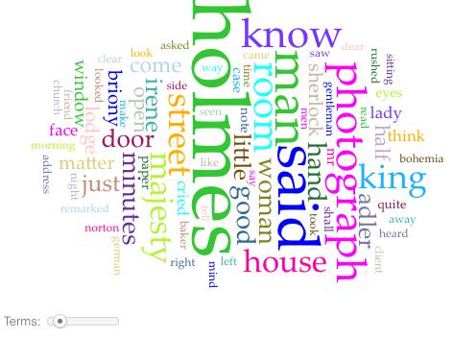
Bag of Words in Voyant
voyant-tools.org

Slide 10
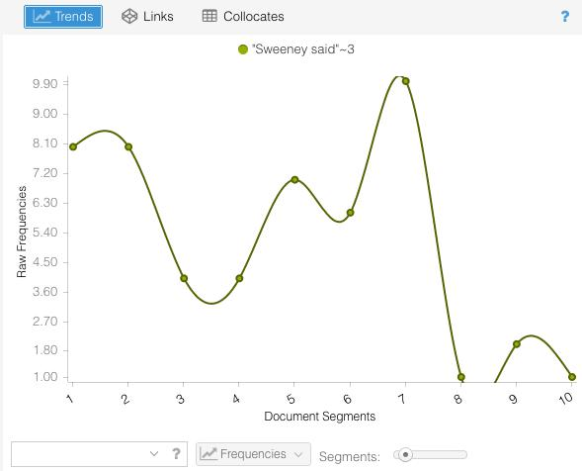
Voyant

Slide 11


Using Voyant:
Go to voyant-tools.org and type in
a url from wikipedia in the
prompt, such as
https://en.wikipedia.org/wiki/Digital_humanities

Slide 12
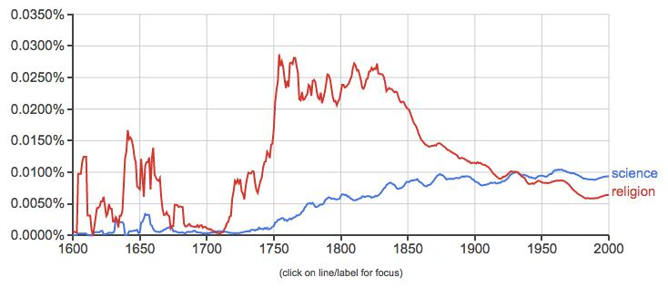
Google N-Grams
https://books.google.com/ngrams

Slide 13
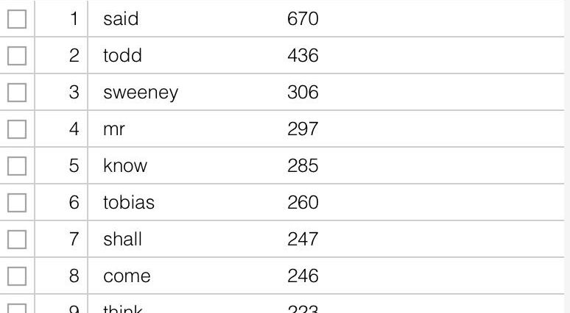
Concordance with Stopwords

Slide 14
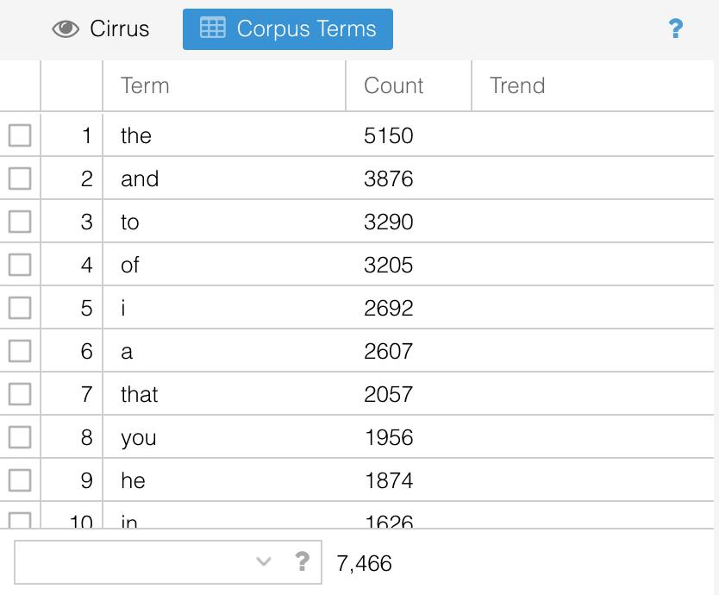
Concordance Without Stopwords

Slide 15
Further Applications with text analysis

Slide 16
Topic Modeling
Texts are about something – themes/topics
Vocabulary lets us know this.
So if we know the words, we can infer the topics.
But, more specifically, we want to look at clusters of words.

Slide 17
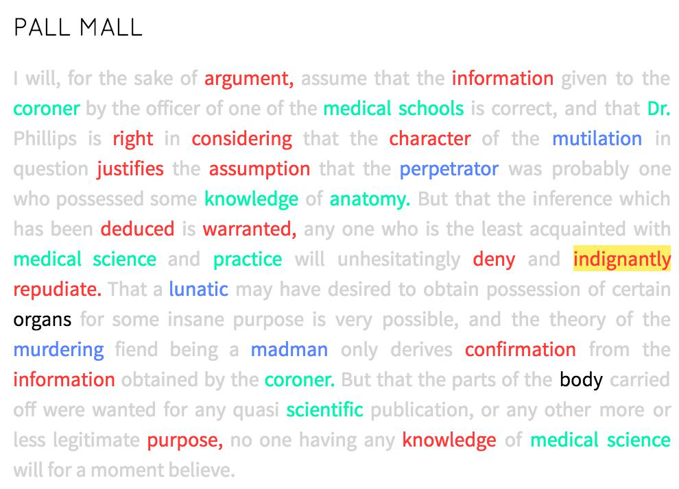
Topic Modeling
red: evidence
green: medicine
blue: murder

Slide 18
Topic Modeling
Runs over a corpus
Pulls out statistically significant clusters of words in each document
More sophisticated than simple word counts
Gets at underlying themes/topics in docs

Slide 19
Sentiment Analysis
"It
was
the
best happy!/positive/1
of
times,
it
was
the
worst sad!/negative/0
of
times…"

Slide 20
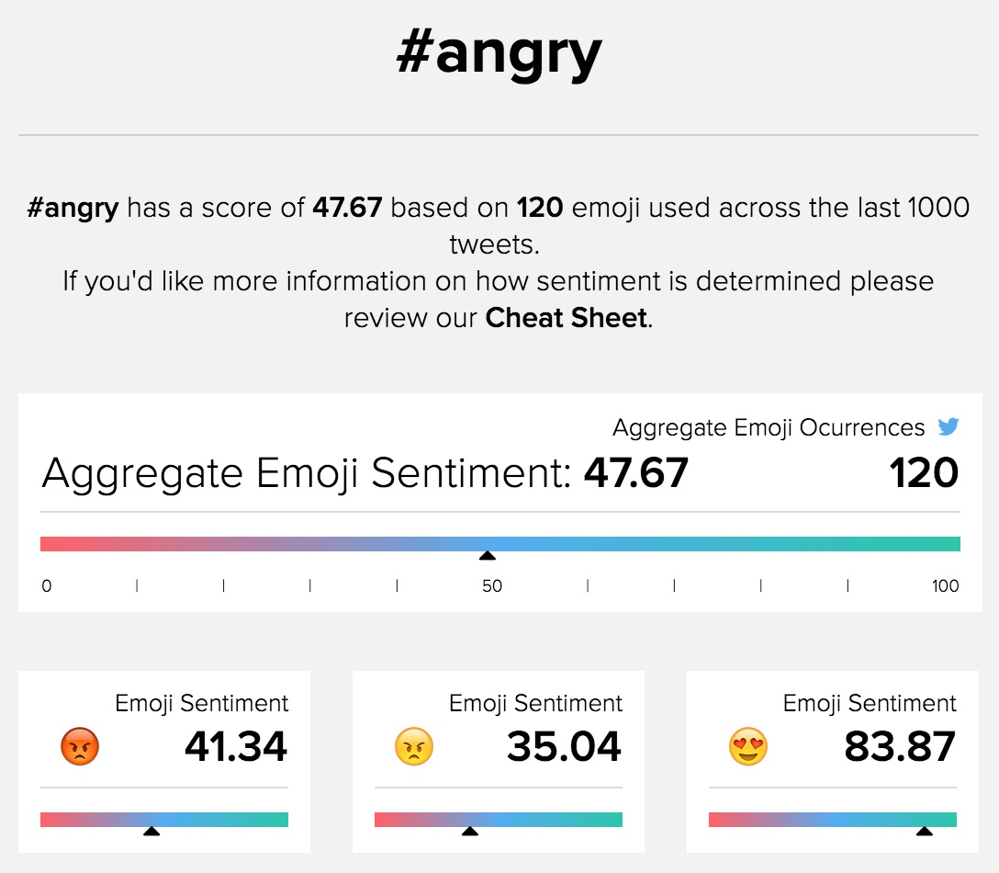
Sentiment Analysis
emojisentiment.com

Slide 21
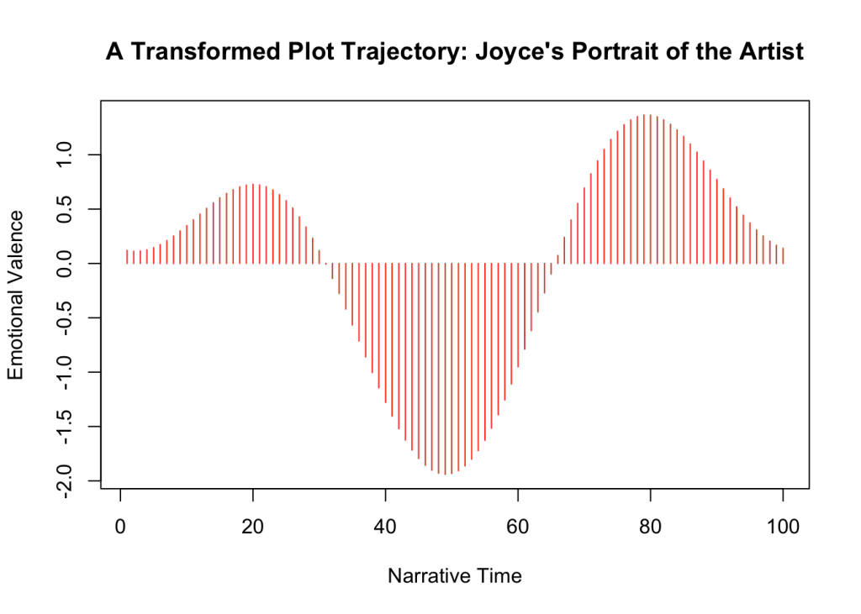
SenTiment Analysis
http://www.matthewjockers.net/2015/02/02/syuzhet/

Slide 22
Recap of Online Resources to Explore
As we’ve seen, you can do some interesting things with quantitative text analysis without ever programming at all! You may want to explore the following online resources further:
voyant
google n-grams

Slide 23
Recap of Applications for Text Analysis
Two applications we discussed for text analysis from a conceptual point of view were:
Topic modeling
Sentiment analysis

Slide 24
Text Analysis with python
script1.py — about python basics
script2.py — starting to do some text analysis with python

Slide 25
Python Basics
Variables
Lists
Functions
Operations
For Loops
If Statements
Dictionaries

Slide 26
Variables
Think of a variable as a box for holding a piece of information
Variables can be:
String type — they are characters or letters between two quotation marks
Integers — they are a whole number
Float — they have a decimal point
Take a look at the first section of script1.py

Slide 27
Lists in Python
A list is a variable that is collection of numerous different elements.
An individual element of a list can be called by referencing its index.
anexamplelist = [‘computer’,’tree’,17, 2.5]
print (anexamplelist[1])
## ‘tree’

Slide 28
For Loops
A control flow statement that allows a process to be iterated (repeated)
catbreeds = ["persian", "tabby", "sphinx", "domestic shorthair"]
for breed in catbreeds:
print (breed)

Slide 29
Defining Functions
We saw some in-built python functions. Let’s write our own now. Functions are declared with the def keyword in python.
def multiplysomething(thethingtobemultiplied):
product = thethingtobemultiplied * 2
return product
result = multiplysomething(5)
print (result)

Slide 30
If Statements
vegetables = [“peas”,”celery”,”broccoli”,”cauliflower”,
”carrots”,”parsnips”, “tomato”]
for vegetable in vegetables:
if len(vegetable) < 5:
print ("short word")
elif len(vegetable == 5:
print (“medium word”)
else:
print (“long word”

Slide 31
Dictionaries
Say you want to link the elements of one list with another. This is done by creating a dictionary
cities = ['Tokyo','Moscow','Chicago','Barcelona']
countries = ['Japan','Russia','USA','Spain']
countriesandcities = dict(zip(countries, cities))

Slide 32
Script2.py
We are going to read in a short story as a flat .txt. file.
Open your tutorial script in IDLE or another text editor
Look at the following line:
This declare a variable called ‘story’ and places the entire text into it
story = open( 'story.txt', mode='r', encoding='utf8').read()

Slide 33
Script2.py
Python prefers .txt files
.txt and .csv are known as “flat” files, and are much easier for python to parse than documents that take up more memory like Word and Excel files
.pdf files need to be converted into .txt files for text analysis. For example, this is what OCR does.

Slide 34
Worksheet — Using Common Python Packages
In our last “package-free” python script, we created tokens using the split() function on string to create a list.
However, there are some downsides to this, an nltk makes this easier.
This exercise allows you to see just a few of the things that you can do with python packages.

Slide 35

What next?Further Resources For Text Analysis with Python

